Slide 1
Purchasing 101

Slide 2
What Does Purchasing Do?
The general responsibilities and functions of the Purchasing Section are as follows:
  1. To purchase supplies, materials, equipment, and services related thereto for the various departments of the University in such a manner that maximum value is obtained for every dollar spent, and to ensure that bona fide, qualified suppliers are given equal opportunity to participate in furnishing University requirements.
  2. To expedite the delivery of materials to meet the requirements of the requesting department.
  3. Assist in resolving discrepancies in shipments not resolved by Requesting Department and Central Receiving.
  4. To conduct all correspondence with suppliers relating to the following purchase order types: Request for Quote (RQ) and Sealed Bids (SB).
  5. To consolidate purchases wherever possible and thus obtain quantity discounts for such volume purchases.
  6. Monitor purchases to ensure the University Warehouse is properly utilized.

Slide 3
Responsible Area
All departments located across Northwestern State University campuses, including:
  Natchitoches
  CENLA
  Fort Polk
  Shreveport

Slide 4
Purchasing Does Not Handle
Invoices- Accounts Payable
Budget Revisions- Accounting & Reporting
Grants- Accounting & Reporting
Finance Access Request- Data Entry
Updates to Budget Unit Head & Approvers- Data Entry
Extra Service or Non-Credit Presenter Contracts- Human Resources
Updates to Employees Address- Human Resources

Slide 5
Purchasing Authority
Employees do not have the authority to enter a contract on behalf of the University without specific delegated authority
  No employee may:
    offer employment to anyone
    enter any professional, personal, or consulting contract
    procure goods and services
    enter any other contracts for any purpose, such as co-operative agreements with other entities, joint venture, etc.

Slide 6
Prohibited Expenditures
Alcoholic Beverages and Liquor
Sales Tax
Any expenditure requiring prepayment or a deposit
Food and Drink for Employee/s
  Coffee Breaks
  Office Parties
  Visiting Students and Parents
  Spouses and Children of Employees
  Food purchases or catering service from University employees
Certain meals
  Office meetings
  Faculty of Staff Development Meetings
  Retreats
Hospitality Supplies
  Coffee makers
  Coffee
  Soft Drinks
  Snacks
  Bottled Water

Slide 7
Artificial Division of Purchasing
No purchase shall be “artificially divided” to avoid procurement procedures
Examples:
  Submitting two or more requisitions of $10,000 each or less for the same items in the same day or week
  Submitting two or more requisition of $10,000 each or less to the same vendor one the same day or week
  Submitting two or more requisitions of $10,000 each or less for the similar items or to similar vendors in the same day or week

Slide 8
Direct Pay
A Direct Pay eliminates the need for a Requisition, Purchase Order and Receiving
A Direct Pay should only be used when items have already been picked up and invoiced
All purchases must be made in accordance with current Executive Order for Small Purchase Procedures and are less than $500
Must have the “Prepared By”, “Budget Unit Head” and “VP/President” signatures
Make sure to check your budget before submitting a Direct Pay
Submit form to nsuacctspay@nsula.edu

Slide 9
Accounts Payable Voucher
An Accounts Payable is connected to a Purchase Order
Only needs “Prepared By” and “Budget Unit Head” signatures
Submit form to nsuacctspay@nsula.edu

Slide 10
JML 25-104 Small Purchases
Executive Order
Purchases up to $60,000
Confirming Order <$5,000
Orders Not Exceeding $30,000
Telephone Quotes $30,000 < $60,000
Non-Competitive
Sealed Bids > $60,000

Slide 11
Confirming Orders
Delegated authority is granted to the requesting budget unit for this procurement.
The “Confirming Purchase Order” (PO Type CO) is procurement of services, supplies, and materials that are:
  Picked up by the requesting department from off-campus vendors or
  An order was placed verbally with the vendor and the vendor does not require a purchase order.

Slide 12
Confirming Orders
Invoices Greater Than $500
  A Requisition must be entered in Banner. The Invoice Number or Receipt Number should be included in the Document Text section of the Requisition.
  A copy of the invoice must be emailed to Purchasing at purchasing@nsula.edu for review and approval.
  The original invoice or receipt must also be sent to Business Affairs – Accounts Payable.
  An Official Purchase Order is issued.
  The requesting department processes on-line receiving.

Slide 13
Orders Not Exceeding $10,000
PO Type: NW – Orders Not Exceeding $10,000
Purchase Order is issued to vendor.
Delegated authority is not granted to the requesting budget unit for this procurement

Slide 14
Orders Not Exceeding $10,000
The following are required to complete the procurement process:
  A Requisition must be entered in Banner. The Quote Number or Estimate Number should be included in the Document Text section of the Requisition.
  A copy of the invoice must be emailed to Purchasing at purchasing@nsula.edu for review and approval.
  Purchasing will issue an Official Purchase Order and email it to the vendor.
  The original invoice or receipt must also be sent to Business Affairs – Accounts Payable.
  The requesting department will complete on-line receiving once items have been delivered.

Slide 15
Telephone Quotes
Orders $30,000 but not exceeding $60,000
PO Type: TQ – Telephone Quotes ($30K - $60K)
Purchase order is issued to vendor.
Price quotations shall be solicited by the Requesting Department from three (3) or more bona fide, qualified vendors for purchases exceeding $30,000 but not exceeding $60,000.
Quotations may be made by telephone, facsimile, written, or other means and shall be awarded on the basis of the lowest responsive quotation unless such quotation is impracticable or unreasonable.

Slide 16

Telephone Quotes
The following are required to complete the procurement process:
  Completed and Approved Purchase Requisition. Must be entered in Banner with all appropriate approvals.
    Must enter Quote Number in Document Text.
    Include detailed description of goods or services, account codes, and vendor information.
  2. Supporting Documentation:
    Signed Telephone Quotation Tabulation form (Purchasing website under General Forms).
    Email original quote from successful vendor to Purchasing at purchasing@nsula.edu.
  3. Purchase Order:
    Purchasing will issue an official Purchase Order and email it to the vendor.
  4. Invoice Submission:
    Send the original invoice or receipt to Business Affairs – Accounts Payable.
  5. Timely Submission
    All documents must be submitted promptly to avoid processing delays.
    Once items have been delivered the requesting department will complete online receiving.

Slide 17
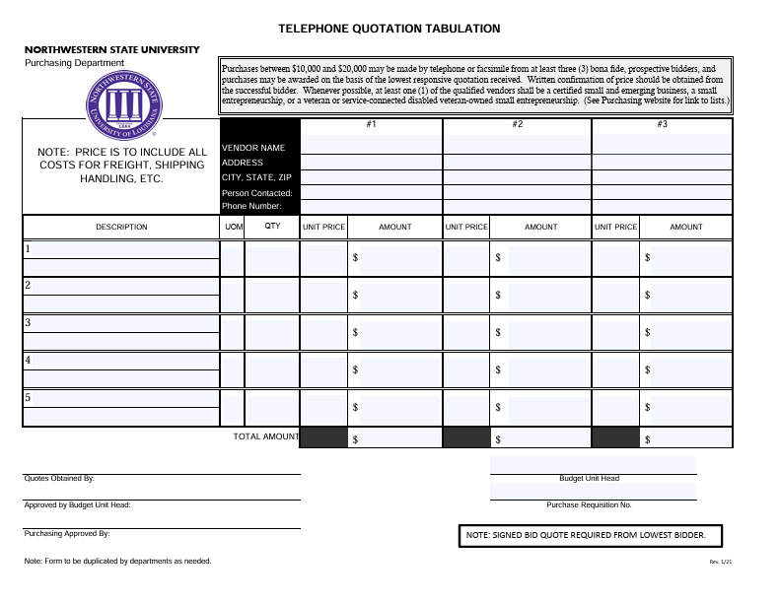
Telephone Quotes

Slide 18
Printing Services
On-Campus Printing Services PO Type: UP – University Printing
All University printing projects should be submitted to the NSU University Print Shop unless scheduling, equipment limitations, or complexity of work requires external services.
Procedure:
  The Budget Unit Head or Requesting Department must initiate a Banner Purchase Requisition using PO Type “UP” for all on-campus printing jobs.
  If University Printing is unable to fulfill the request, the department must follow the Off-Campus Printing procedure (see Section II).

Slide 19
Printing Services
Off-Campus Printing Services (Not to Exceed $10,000)
PO Type: NW – Order Not Exceeding $10,000
Off-campus printing may only be used when:
  The NSU Print Shop cannot complete the project, and
  The Louisiana Office of State Printing is unable to handle the work.
All external printing services must follow applicable Order Not Exceeding, Sealed Bid, or State Contract procurement procedures.

Slide 20
Printing Services
Reminders:
  NSU’s internal print shop must always be the first point of contact.
  External vendors may only be used after NSU Printing and State Printing confirm they cannot complete the project.
  All procurement steps must follow the University’s purchasing policies and applicable Executive Orders.

Slide 21
Invitation to Bid
PO Type: SB – Sealed Bid (> $60,000)
Purchasing Office Only
Purchase Order is issued to vendor
Purchases where the estimated cost is over $60,000 shall be made by sending out written Invitations for Bids to persons in a position to furnish the supplies, services and major repairs required and by advertising in accordance with R.S. 39:1594.
The Purchasing Department will be required to publicly advertise the purchase. The Purchasing Department will solicit formal Invitations for Bids via LaPAC in a sealed bid format for a minimum of (21) days unless a (10) day period is determined necessary by the Purchasing Department. (LA Administrative Code 34: I501.A1 & 34:I503.)

Slide 22
Invitation to Bid
Budget Unit Head Responsibilities:
  Budget Unit Heads are required to review bid responses prior to issuance of a Purchase Order for the following PO Types:
    TQ – Telephone Quote ($30K–$60K)
    SB – Sealed Bid (>$60K)

Slide 23
State Contract
PO Type: SC – State Contract
Purchase Order is issued to vendor
State Contracts are term agreements created by the Division of Administration, Office of State Procurement.
  They cover materials, supplies, and equipment and do not require competitive bidding.
  These contracts are accessible via LA-eCat, the state's electronic procurement portal.

Slide 24
State Contract
Examples of State Contract Vendors:
  Staples
  Office Depot
  Grainger
  The HON Company
  Apple
  Dell
  Fastenol
Louisiana’s Electronic Catalog (LA eCat) https://wwwcfprd.doa.louisiana.gov/OSP/LaPAC/eCat/dsp_eCatSearchLagov.cfm

Slide 25
Public Works; Louisiana’s Public Bid Law, R.S. 38:2211-2296
PO Type: PW – Public Works
Restricted to the Purchasing Office Only
Purchase Order is issued to vendor.
Public Works Contracts involve the erection, construction, alteration, improvement, or repair of public facilities or immovable property owned, used, or leased by a public entity. These projects are subject to Louisiana’s Public Bid Law and typically follow the design-bid–build method using public funds.
  Contract Limit: Public works projects not exceeding $150,000 do not require formal advertisement or bidding.
  Contract Threshold: Projects over $150,000 must be publicly advertised and awarded to the lowest responsive and responsible bidder.

Slide 26
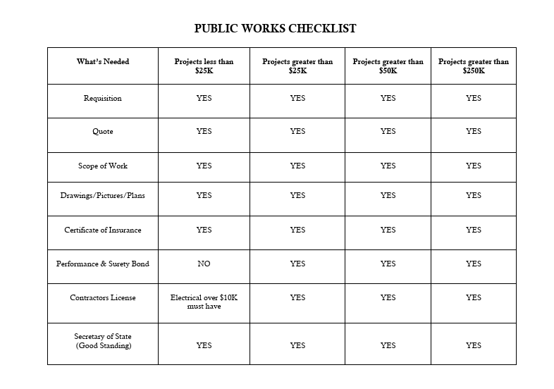
Public Works

Slide 27
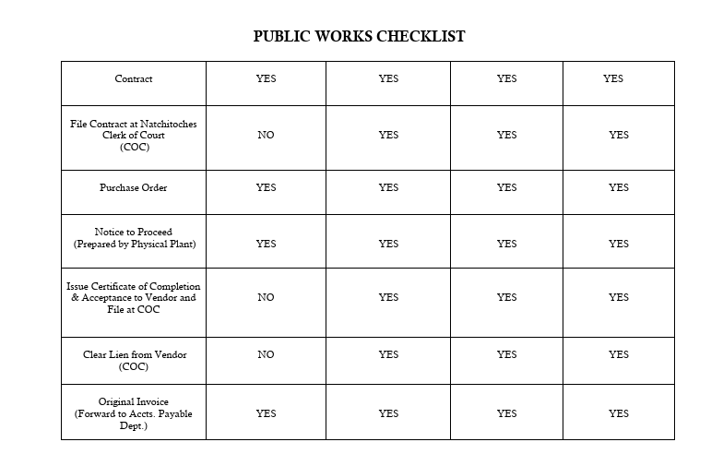
Public Works

Slide 28
Emergency Purchases
In accordance with Louisiana Procurement Code R.S. 39:1598
  an emergency condition is defined as: “A situation which creates a threat to public health, welfare, safety, or property, such as may arise by reason of floods, epidemics, riots, equipment failures, or such other reasons as may be proclaimed by the chief procurement officer.”
  Note: Poor planning does not constitute an emergency condition.
PO Type: EP – Emergency Purchase
Purchase Order is issued to vendor

Slide 29
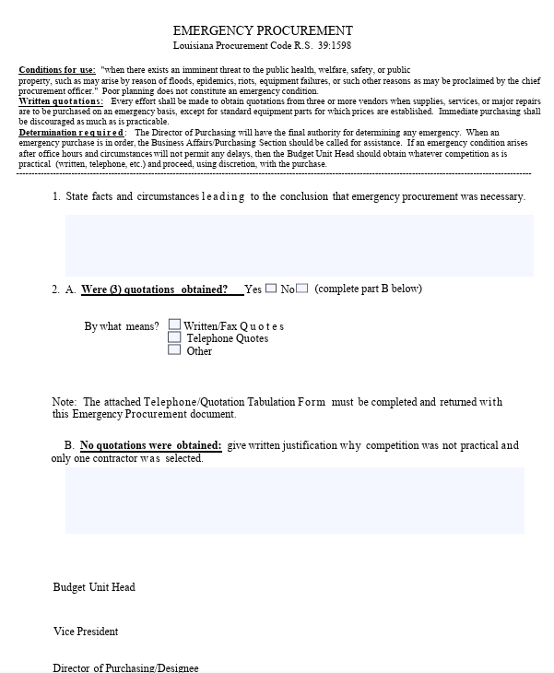
Emergency Purchases
Procedure During Business Hours If an emergency arises during business hours:
  Contact the Purchasing Section immediately for assistance.
  Provide a description of the emergency and the materials or services needed.
  The Director of Purchasing will determine if the request qualifies as an emergency under state procurement law.
Procedure Outside Business Hours If an emergency arises after office hours, and delays are not possible:
  The Budget Unit Head or an authorized representative may proceed with the purchase using discretion.
  Obtain as much competition as practical (via written quotes, phone calls, etc.).
  Proceed with the necessary purchase to address the emergency.

Slide 30
Emergency Purchases
After the emergency purchase is made:
  Complete the NSU Emergency Declaration Request Form
  Provide a written justification, signed by the Budget Unit Head or designee, explaining:
    The nature of the emergency
    The competition attempted, if any
  Submit the documentation to the Purchasing Section as soon as possible.
All emergency justifications are subject to final review and approval by the Director of Purchasing.

Slide 31
Sole Source Purchases
In accordance with Louisiana Procurement Code R.S. 39:1597
PO Type: SS- Sole Source
Purchase Order is issued to vendor
Sole source procurement is permitted without competition when, under applicable regulations, the Director of Purchasing or their designee (above the level of procurement officer) determines in writing that there is only one source for the required supply, service, or major repair item.

Slide 32
Sole Source Purchases
Conditions for Use of Sole Source Procurement
1. Justification by Budget Unit Head
Any request from a Budget Unit Head to restrict procurement to a single vendor must be accompanied by a written explanation detailing why no other source is suitable or acceptable to meet the need.
2. Single Source Requirement
Sole source procurement is permissible only if the requirement is truly available from a single supplier.
Note: A proprietary item alone does not justify sole source procurement if more than one potential vendor or manufacturer exists.

Slide 33
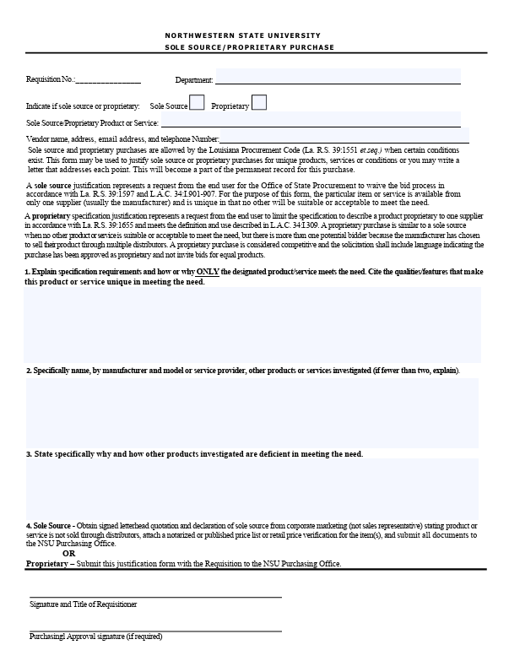
Sole Source Purchases
Examples of Acceptable Sole Source Circumstances
  Compatibility Requirements
    When compatibility with existing equipment, accessories, or replacement parts is the paramount consideration.
  Trial Use or Testing
    When an item from a sole supplier is required for trial use or product testing.
  Resale Purposes
    When the procurement is for items intended for resale.
  Public Utility Services
    When purchasing public utility services that are available from only one provider.

Slide 34
Non-Competitive Purchases
In accordance with Executive Order No. JML 25-104 Section 5: A. Non-Competitive that Exceeds $30,000
  https://doa.louisiana.gov/media/rimbcl1w/jml-25-104-small-purchase-procedures.pdf
PO Type: NC – Non-Competitive
Purchase Order is issued to vendor
Purchasing authority is given to requesting budget unit for this procurement.

Slide 35
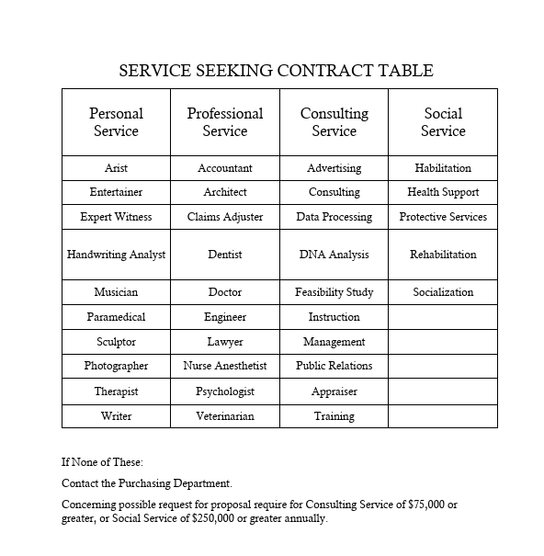
Professional Service Contracts
Updates to Professional Service Contracts:
  Examples of Services
  New Contract for services up to $2,000
  Individual Questionnaire Form
  Checklist for contract
All supporting documents can be found on the Purchasing Website under the Professional Service Forms.
Updated Policy: https://documentproviderviewer.nsula.edu/?id=15317

Slide 36
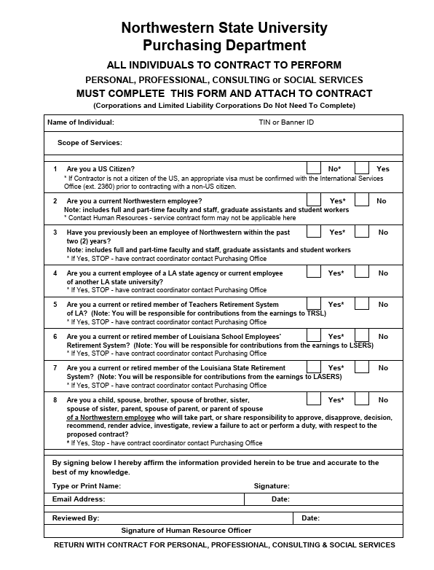
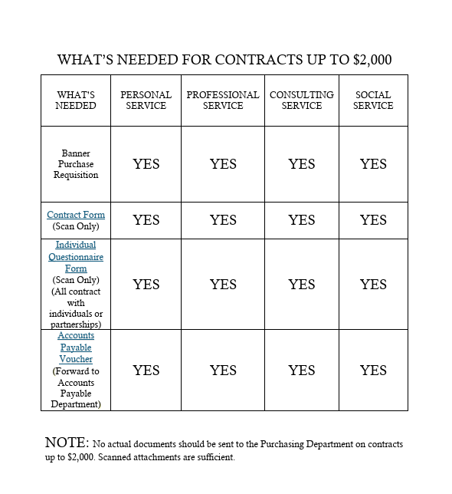
Professional Service Contracts

Slide 37
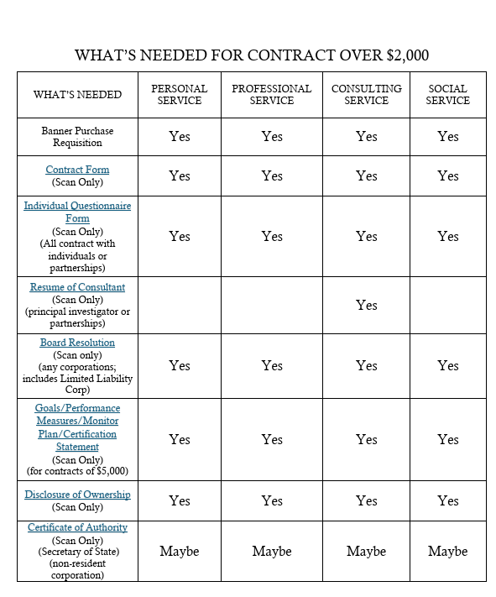
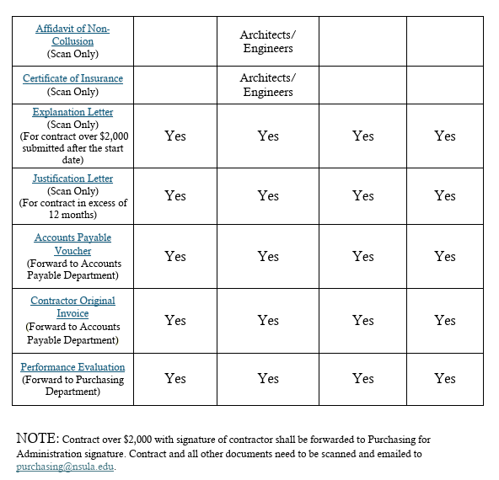
Professional Service Contracts

Slide 38
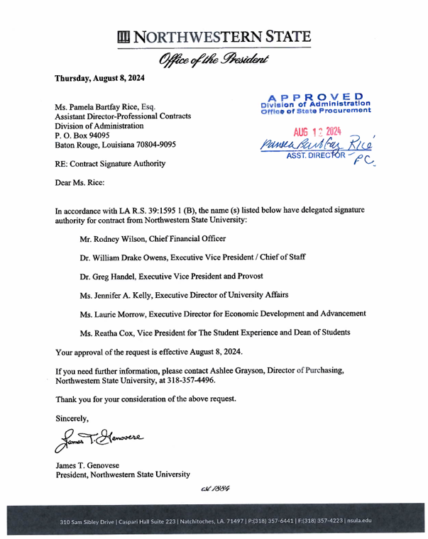
Professional Service Contracts
Who has Contractual Authority?
  The authority to sign University contracts resides with the President of Northwestern State University.
  However, this authority is delegated to the Vice Presidents for certain contracts:
  Personal, professional, consulting, or social services contracts up to $49,999;
  Excludes legal, architectural, and auditing/accounting services.
No other employee is authorized to sign contracts involving:
  The expenditure of any funds, regardless of source;
  Agreements requiring University resources;
  Contracts not specifically delegated.

Slide 39
Updates to Meals Policy
Now under “Food Policy and Procedure”
All meals shall be preapproved and encumbered on a Banner Requisition prior to the event.
On-Campus Departments and University sponsored events may not self-cater; specifically, the contracted food service company (Sodexo) must cater for all University events. This means that the campus food service contractor must provide all food and beverage service
If a department would like to use an outside vendor, they must obtain a waiver from Sodexo stating they are unable to meet the needs of the event.
This means there will also be no more reimbursements for food.

Slide 40
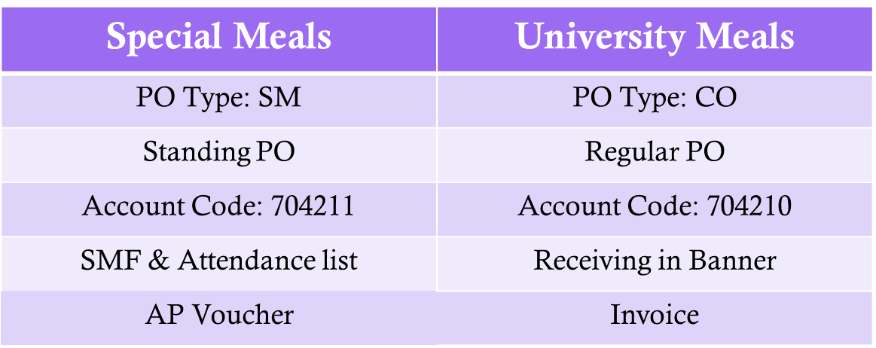
Types of Meals

Slide 41
Special Meals (704211)
Special Meals (SM): meals restricted to certain group of people
  Ex. Faculty Professional Development meeting and Candidates for Employment
Allowances: Breakfast - $16.00, Lunch - $19.00, Dinner - $28.00
  Overage with approval form Vice President/President: Breakfast - $20.00, Lunch – $23.75, Dinner - $35.00
A Request for Special Meals Form must be submitted to Vice President/President for approval prior to meal
    Name of title of person requesting Special Meal
    Date and time of Special Meal
    Number of participants and price per meal
    Explanation as to why the Special Meal is required

Slide 42
Special Meals
The completed and approved Request for Special Meal must be submitted to the Purchasing office once the meal has been provided
  Actual cost of the Special Meal
  Names/affiliation of participants who received the Special Meal
  Banner Requisition number
Copy of invoice/receipt must be submitted with Request for Special Meals form
Original invoice/receipt must be submitted to NSU Accounts Payable

Slide 43
University Meals (704210)
University Meals (CO): meals open for individuals outside of the University
  Ex. Award Ceremony refreshments and Freshman Connections meals
Allowances: Breakfast - $16.00, Lunch - $19.00, Dinner - $28.00
  Overage with approval form Vice President/President: Breakfast - $20.00, Lunch – $23.75, Dinner - $35.00

Slide 44
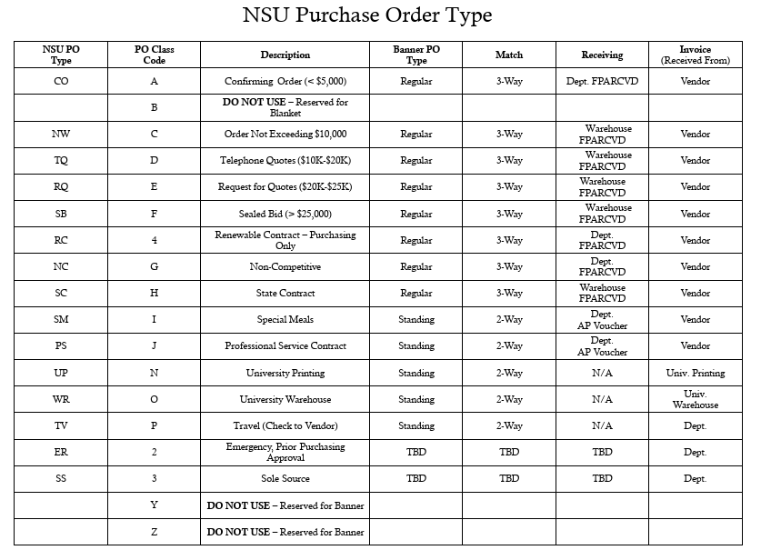
PO Types

Slide 45
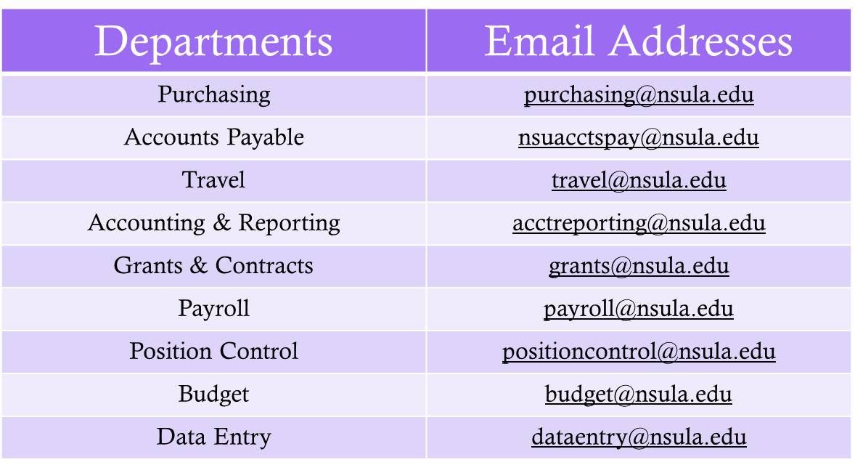
Business Affairs Directory

Slide 46
Questions?

